Slide 1
Firefighters Pension
Scheme 2015
(FPS 2025)
Scheme Introduction

Slide 2
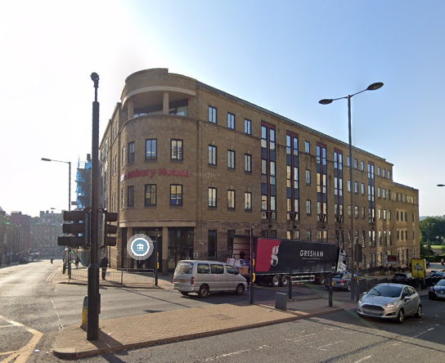
Add in introduction to who you are
[ADD detail]

Slide 3

Hot topics
How are these benefits calculated?
How much could you expect
to build up?
Ill health benefits
Benefits payable on death
Transferring in previous pension benefits
Pensions & divorce

Slide 4
Have you considered?.......
What will you live on when you retire and how old will you be when you receive any pension income?
The basic State Pension in April 2023 is £203.85 per week for a single person and the retirement age will rise to 68 for many of us.
Will that be enough income in retirement?
On its own, the basic state pension is unlikely to provide you with the equivalent of your current standard of living. It’s important to plan ahead!
Notes:
You need to make sure you are doing “something” to look after your financial situation

Slide 5

How much will it cost you?
The Firefighters’ Pension Scheme is an extremely valuable and important part of your employment package.
Your employer shares the cost and will contribute more than you do to the scheme.
Your contribution rate depends on how much you are paid; however, the current rates are between 11% to 14.5%. The rate you pay depends on which pay band you fall into.

Slide 6
Contribution bandings
Band 1 | Pensionable pay up to £27,818 | 11.0%
Band 2 | £27,819 to £51,515 | 12.9%
Band 3 | £51,516 to £142,500 | 13.5%
Band 4 | £142,501 or more | 14.5%
Your employer contributes |  | 37.6%
Notes:
14.3% is same across all FRA’s it’s in the regs.

Slide 7
Key benefits
Life cover of 3 x pensionable pay from the day you join and there are no medical requirements or questionnaires to complete
Tax relief on all your contributions even on extra payments you make to top up your benefits. Currently limited to £8,570.14 per year (2024/25 limits).
No fees or charges you only contribute a percentage of your pay
When can you receive payment the normal pension age is 60 with the option of a reduced pension that can be paid from age 55. However, if you choose to continue your service after 60 there will be an uplift applied to your pension

Slide 8
Key benefits
Pension payable for life with no cap on the length of your service
Tax free lump sum option for all members upon retirement
Guaranteed benefits there is no investment risk and benefits are backed by law
Pension Increases are paid annually from age 55 to those who are in receipt of their pension. Applied from any age if payment is from an ill health pension or a survivor's pension
Ill health benefits available in case you must retire early through ill-health
Adult survivor & children's pensions payable to protect loved ones
Notes:
Lump sum 1 to 12
Pi be vague, cover later in more detail.

Slide 9

How do benefits build up?
FPS 2015 is a career average revalued earnings (CARE) scheme.
Each year you bank a ‘slice’ of pension (1/59.7th) based on your actual pensionable earnings for that year into your pension account.
Each year an ‘index adjustment’ is applied. This would be a percentage increase or decrease ordered by HM Treasury, reflecting the national change in ‘Average Weekly Earnings’ (AWE).
At retirement, the ‘slices’ you have built up are added together and paid as a monthly pension.
At retirement you have the option to give up (commute) some of your pension to provide for a ‘tax free’ lump sum.
Retirements before 60 will have reductions applied to take into account paying the pension for longer.
Notes:
Think about changing photo of cake

Slide 10
How are benefits calculated
Date from | Date to | Account balance (starting) £ | Actual pay £ | Pension build up in year (1/59.7) £ | Total pension £ | Annual increase | Account balance (closing) £
01/04/2020 | 31/03/2021 | 0.00 | 29,850 | 500.00 | 500.00 | 3% | 515.00
01/04/2021 | 31/03/2022 | 515.00 | 30,447 | 510.00 | 1,025.00 | 4% | 1,066.00
01/04/2022 | 31/03/2023 | 1,066.00 | 31,000 | 519.26 | 1,585.26 | 3% | 1,632.81

Slide 11
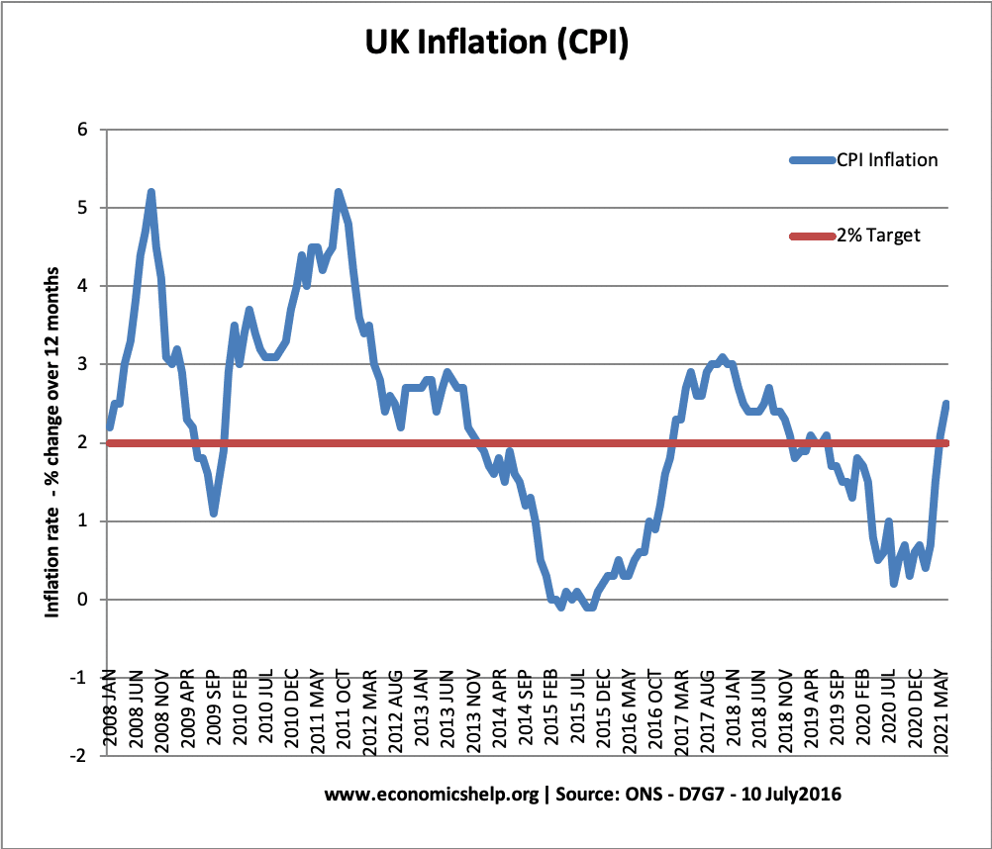
What is the increase?
Your pension benefits are increased each year to reflect changes in the cost of living
in line with Average Weekly Earnings (AWE) whilst active
Consumer Price Index (CPI) if the pension is deferred or a pensioner

Slide 12
How much could you expect to get
Joined at 21 as a trainee firefighter (starting salary £27,178)
Remained a firefighter
Retired at age 60 with 39 years' service retiring on a salary of £36,226
Annual pension of £23,600 (no lump sum)
or
Annual pension of £17,700 + tax free lump sum £70,800
(25% of £23,600 = £5,900 which is multiplied by 12)
A
B
Notes:
Figures for illustration purposes only, not actual current figures.
Not relevant to slide but remember
Salary review date 1st July
Scheme year 1st April to 31 March.

Slide 13
Ill health benefits
If you retire from the fire authority due to ill health an Independent Qualified Registered Medical Practitioner will recommend if you are either:
  incapable of performing any of the duties of the role in which you were last employed, because of incapacity of mind or body which will continue until normal pension age (60)
  you are also incapable of undertaking regular employment because of incapacity of mind or body which will continue until normal pension age
Your employer will make the ultimate determination based on this recommendation and this will determine whether you receive an:
  Lower tier Ill Health Pension, or
  Higher tier Ill Health Pension

Slide 14
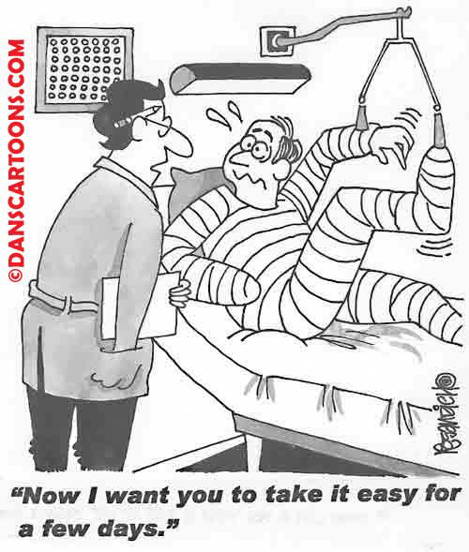
Ill health benefits
Lower Tier
  Calculated on your accrued (built up) service to date of retirement with no early retirement reductions applied
  (requires 3 months service)
Higher Tier
  Must have been a member for 5 years
  Lower tier benefit PLUS
  2% of pre commutation earned pension × number of years to age 60

Slide 15
Benefits payable on death (active members)
The benefits payable are slightly different depending on whether you are an active, deferred or retired firefighter.
Active Firefighter
Death Grant payable of 3 times pensionable pay, irrespective of length of service (nomination form available to complete)
Adult survivor benefits payable to a spouse, civil partner or cohabiting partner

Slide 16
Benefits payable on death (active members)
Children’s Benefits are payable to a Natural / Stepchild / Adopted Child or any other child who is either related to the member or a child of their husband, wife, civil partner or cohabiting partner.
  Providing the child is under age 18.
  Between age 18 & 23 if in full time education.
  For life if the child is unable to engage in regular employment due to physical or mental impairment which is likely to be permanent .

Slide 17
Benefits payable on death (active members)
What's payable
Adult survivor
50% of the ill-health pension that you would have received if you had been permanently incapacited at the date of death.
Children's benefits
25% of the ill-health pension that you would have received if you had been permanently incapacitated at the date of death.
Up to 50% if more than one child (divided by the number of eligible children), e.g. 4 eligible children would receive 12.5% each

Slide 18
Benefits payable on death (deferred members)
    The benefits payable to survivors following the death of a firefighter who has left employment with deferred benefits are:
    Adult Survivor Benefits payable are based on 50% of the firefighters’ deferred pension
    Children's pensions are also based on the firefighters‘ actual pension and remain 25% or 50% divided by number of eligible children

Slide 19
Benefits payable on death (pensioner members)
  The benefits payable to survivors following the death of a firefighter who is already in receipt of their pension are:
    5 year guarantee lump sum
    Adult Survivor Benefits payable are based on 50% of the firefighters’ actual pension
    Children's pensions are also based on the firefighters‘ actual pension and remain 25% or 50% divided by number of eligible children
  If you are both an active and pensioner member at the date of death, the highest lump sum death benefit would be payable.
Things to remember for both active, deferred and pensioner members:
Significantly younger spouse / civil partner / cohabiting partner: there is a possible reduction to benefits (2.5% for every year or part year by which he or she is more than 12 years younger, up to a maximum reduction of 50%)

Slide 20



Transferring previous pension benefits into FPS 2015
If you have been a member of another pension scheme you may be able to transfer those benefits into the FPS.
You are encouraged to do this within 12 months of commencing employment.
Transfers can take several months to be completed so it is best not to delay.
If you have other firefighters’ pension benefits you may be able to link these to your new record (providing that they do not overlap)

Slide 21
Transferring in previous pension benefits into FPS 2015
Former scheme type | Time limit
Club transfer | 12 months of joining
Non Club – occupational scheme | No restriction
Non Club – non occupational | One year (but with FRA discretion to extend)

Slide 22

Leaving the scheme before retirement
If you are thinking of opting out of the scheme, it is encouraged that you understand the implications to this and suggest that you read the opting out factsheet.
If you leave within 3 months your pension contributions would be refunded from the scheme (if you do not have any other records)
Leave with more than 3 months service your pension benefits will be deferred until the normal pension age of the scheme (which is your state pension age currently age 68). As the normal pension age is linked to your state retirement age this could increase.
You can transfer your FPS 2015 pension benefits to another arrangement, but the scheme rules contain strict criteria governing the kind of arrangement you are able to transfer to.

Slide 23

Pensions & Divorce
When getting divorced couples or the courts usually come to an agreement as to how assets will be divided. Property, cars, savings and any pensions will be considered.
To decide how a pension should be shared the courts will need to know the Cash Equivalent Transfer Value (CETV).
If you require information on pension sharing on divorce or a CETV, contact XXXX who will provide you with a guide to explain, and help you through this process.

Slide 24
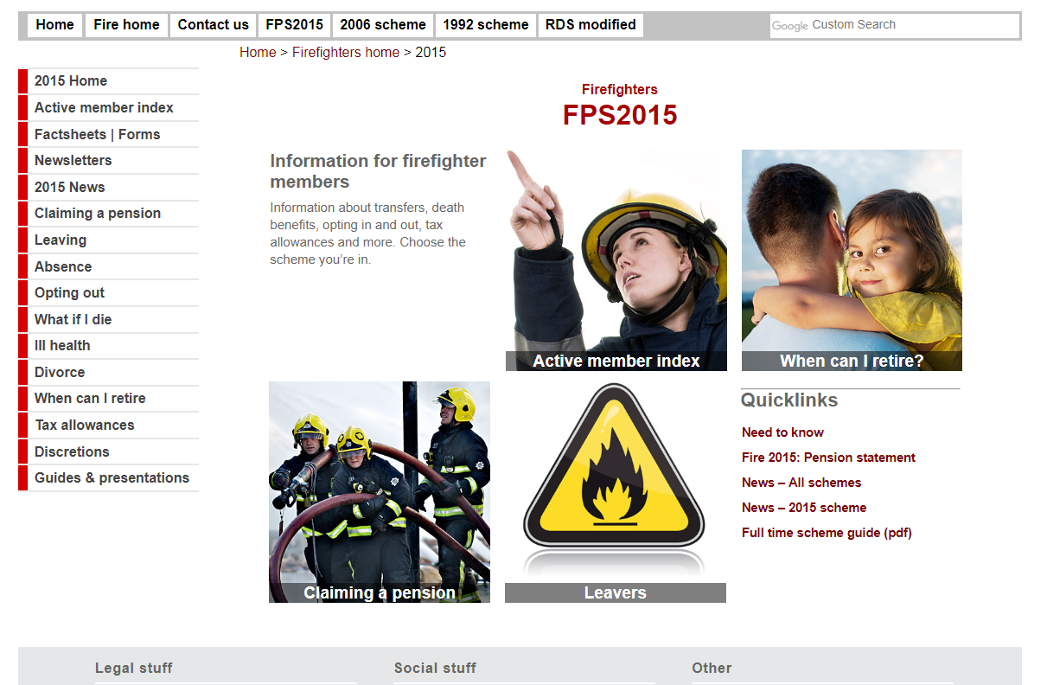
Want to know more?
Useful links:
FPS member website:
https://fpsmember.org
FPS regulation and guidance website:
https://www.fpsregs.org
Visit our website
[ADD website]

Slide 25


Contact Information
XXXXXX
[ADD CONTACT DETAILS]

